Slide 1
CHRONIC KIDNEY DISEASE STAGE INDENTIFICATION IN HIV INFECTED PATIENTS
By using machine learning
K.Ramya Sri (227Y1A12A4)
T.Sahithi (227Y1A12A6)
K.Sirisha (227Y1A12B3)

Slide 2
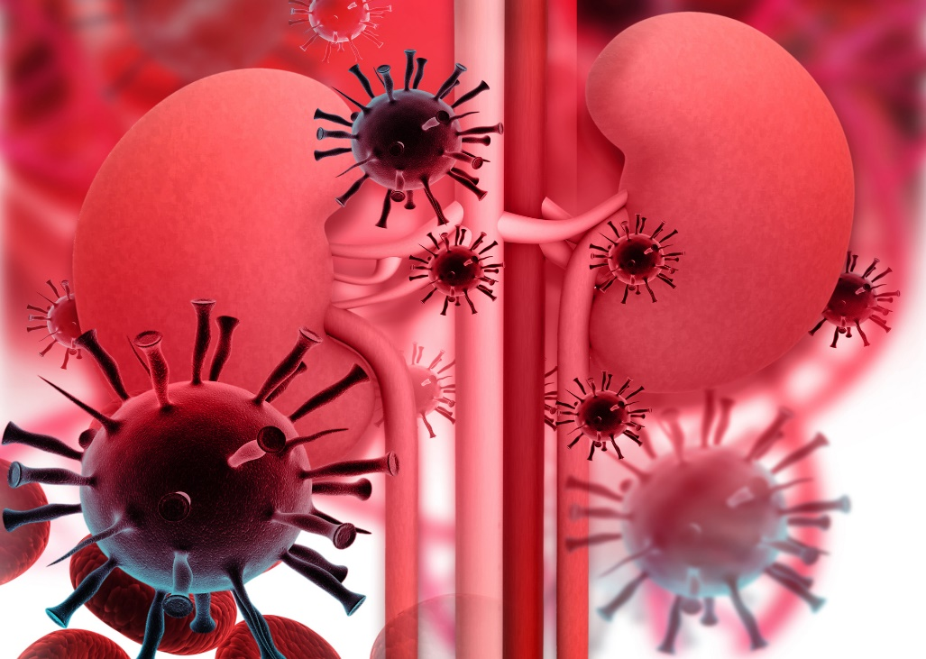
INTRODUCTION:
A longstanding disease of the kidneys leading to renal failure which causes Chronic kidney disease
Dialysis and kidney transplantation are treatments for severe kidney failure, also called kidney (or renal) failure, stage 5 chronic kidney disease.
Due to high treatment cost only 10% of the people choose dialysis process in worldwide
Few research has identified related of CKD with HIV
Patients who have HIV, has chances of getting kidney disease are even greater

Slide 3
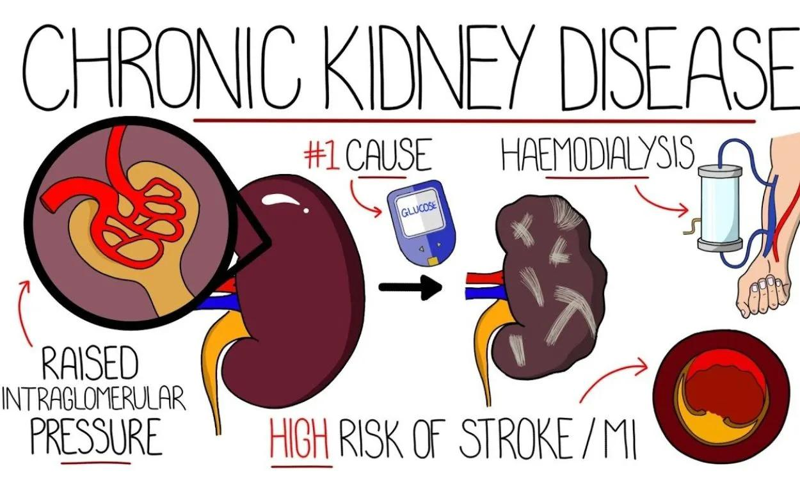
IDENTIFICATION OF KIDNEY PROBLEMS:
If a urine test finds higher levels of protein in urine this may be a sign of kidney problems.
A healthy kidney retains protein in blood and excretes creatinine in urine. When the kidney is damaged, it may do the opposite.
Taking HIV treatment will also help keep kidney disease under control. Because kidney damage impairs the body’s ability to remove drugs, your doctor may need to adjust the doses of some of your anti-HIV drugs and other medications.

Slide 4

WHAT IS HIV?
HIV (human immunodeficiency virus) is a virus that infects and damages your immune system.
Your immune system helps your body defend itself against infection and other disease.
HIV attacks and destroys the disease-fighting cells of your immune system and leaves your body weak against infection and cancer.
HIV destroys white blood cells called CD4T cells.

Slide 5
Are people with HIV at greater risk for getting kidney disease?
Having HIV may put you at risk for getting kidney disease. In fact, it is not unusual for people with HIV to develop kidney disease.
If you have HIV, your chances of getting kidney disease are even greater if you:
Have a high viral load (a large amount of HIV in the blood).
Have diabetes, high blood pressure or Hepatitis C
Have a low CD4 count ( a low number of the blood cells that help fight disease such as HIV)

Slide 6
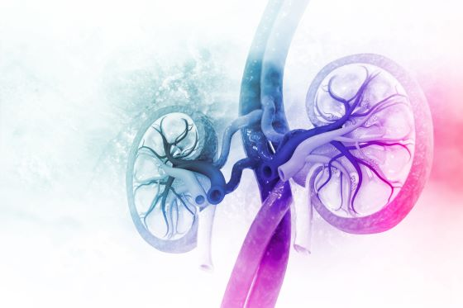
Why does HIV put me at risk for kidney disease?
HIV can harm the nephrons (filters) in your kidneys. When this happens, the filters do not work as well as they should.
HIV can infect the cells in your kidneys
If not carefully monitored, some of the medicines used to treat HIV can harm the nephrons in your kidneys.

Slide 7
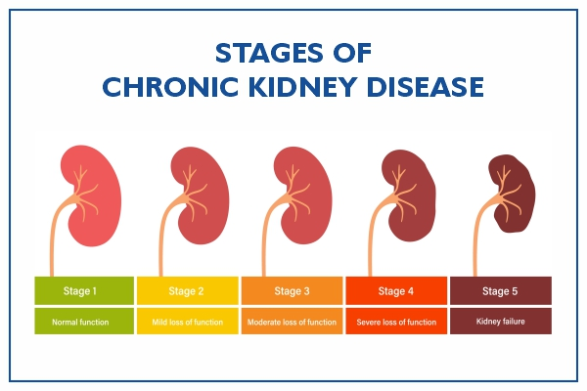
STAGE IDENTIFICATION:

Slide 8
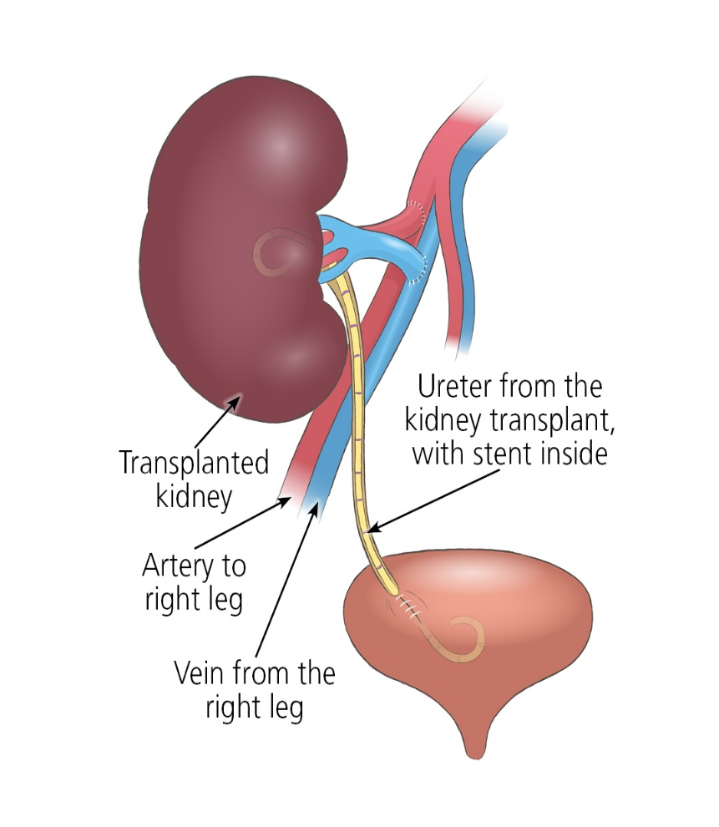
Can a person with HIV have a kidney transplant?
Yes, it is possible for people with HIV to have a kidney transplant.
Maintaining your CD4 count over 200 and have as low of viral load as possible is important.
After receiving a kidney transplant, patients need to take medications that suppress their immune system for the life of the kidney transplant.
A person with HIV can donate a kidney to someone who is HIV positive
organs from HIV-positive donors are only offered to HIV-positive transplant candidates.

Slide 9
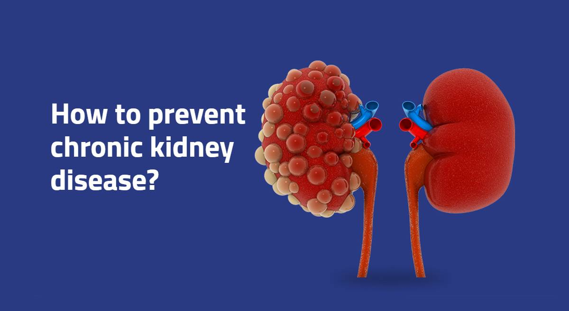

Slide 10
PREVENTION :
If you have HIV, you can lower your chances by:
Checking your blood pressure as often as your doctor recommends and taking steps to keep it under control.
Asking your doctor about HIV drugs that have a lower risk of causing kidney damage
Taking medicines to control your blood glucose, cholesterol, anemia, and blood pressure if your doctor orders them for you

Slide 11
CONCLUSION :
Our study identified a prevalence of CKD of 10.44% by CKD EPI equations among HIV patients . Early screening and follow up of renal functions is important to minimize the risk of developing end stage kidney disease.
The application of machine learning (ML) for identifying chronic kidney disease (CKD) stages in HIV-infected patients holds significant promise for enhancing clinical decision-making and patient outcomes.

Slide 12


